Slide 1



Zomato Restaurants Analytics

Slide 2
Group NO:- 02
Ms. Ranu Krishna Shrivastava
Ms. Sukanya
Mr. Vinodkumar M
Mr. Kiran Sanjay Jaware
Miss. Trisha S
Mr. Talari Moses
Miss. Sayali Rameshrao Naxine

Slide 3
Introduction
In today's digital world, food delivery platforms like Zomato hold a wealth of data about consumer preferences and restaurant performance. Zomato, a renowned online food delivery and restaurant discovery platform, provides a rich dataset that offers a treasure trove of information for analysis. Through Zomato restaurant analytics, we delve into this vast pool of data to uncover hidden patterns, understand customer sentiments, and derive actionable insights for both restaurant owners and consumers alike. By harnessing the power of data analytics, we aim to revolutionize the way we perceive, operate, and experience dining establishments.

Slide 4
Aim
Understanding Customer Preferences:
Identify popular cuisines and restaurant types in different regions.
Analyze correlations between cuisines, price ranges, and ratings.
Discover how factors like online ordering and table booking influence customer choices.
Optimizing Restaurant Performance:
Compare restaurant ratings and reviews to identify areas for improvement.
Explore the relationship between price points and customer satisfaction.
Analyze the impact of online presence and marketing strategies on restaurant visibility.
Informing Business Decisions:
Assess market saturation for various cuisines in specific locations.
Predict customer demand for new restaurant ventures.
Identify trends in online food ordering behavior.

Slide 5
Tools utilized for this chart
Tools used for this analysis is Power BI, Tableau, Microsoft Excel.
Microsoft Excel: A widely used spreadsheet application that allows you to create charts and graphs from data entered into its cells.
Tableau: A paid software program that specializes in data visualization. It allows you to create a wider variety of charts and graphs than Excel or Google Sheets, and it offers more customization options.
Power BI: A business intelligence platform that includes data visualization tools.

Slide 6
KPI 2
Build a Calendar Table using the Columns Datekey_Opening ( Which has Dates from Minimum Dates and Maximum Dates)
Column Name | Description
Datekey_Opening | Unique identifier for each date within the minimum and maximum date range in your data.
Year | The calendar year extracted from the datekey.
Monthno | Numeric representation of the month (1-12).
Monthfullname | Full name of the month (e.g., "January", "February").
Quarter (Q1, Q2, Q3, Q4) | Calendar quarter (1-4) based on the month.
YearMonth (YYYY-MMM) | Combination of year and month in a standardized format (e.g., "2024-Jan").
Weekdayno | Numeric representation of the weekday (1-7, where 1 is Sunday).
Weekdayname | Full name of the weekday (e.g., "Sunday", "Monday").
FinancialMonth (FM1-FM12) | Custom month based on the fiscal year definition (e.g., April = FM1, March = FM12).
Financial Quarter (FQ-1-FQ-4) | Quarter based on the financial month (FQ-1 starts with the first month of FM).

Slide 7
KPI 3
Convert the Average cost for 2 column into USD dollars (currently the Average cost for 2 in local currencies between Shipping days vs Review score
This conversion process transforms the average cost for two diners, currently displayed in local currencies, into a standardized format of USD dollars. It facilitates price comparisons across different locations and enables a broader understanding of restaurant affordability.

Slide 8
KPI 4
Find the Numbers of Restaurants based on City and Country.
This KPI reveals the distribution of restaurants across various cities and countries. It helps identify areas with higher restaurant concentrations, which can be valuable for market analysis, competitor research, and resource allocation decisions.

Slide 9
KPI 5
Numbers of Restaurants opening based on Year , Quarter , Month
This KPI tracks the temporal trends in restaurant openings, providing insights into seasonality, growth patterns, and market dynamics. It allows you to identify peak opening periods and adjust strategies accordingly.

Slide 10
KPI 6
Count of Restaurants based on Average Ratings
This KPI reveals the distribution of restaurants across different average rating ranges. It helps assess customer satisfaction, identify areas for improvement, and inform marketing strategies.

Slide 11
KPI 7
Create buckets based on Average Price of reasonable size and find out how many restaurants falls in each buckets
This KPI segments restaurants into categories based on their average price range. It helps understand customer preferences for different price points and inform menu pricing strategies.

Slide 12
KPI 8
Percentage of Restaurants based on "Has_Table_booking"
This KPI reveals the proportion of restaurants on Zomato that offer table reservation capabilities. It provides insights into customer expectations and helps identify potential areas for improvement in convenience.

Slide 13
KPI 9
Percentage of Restaurants based on "Has_Online_delivery"
This KPI reveals the proportion of restaurants on Zomato that offer online food delivery services. It provides insights into the growing online delivery trend and helps evaluate market saturation or opportunity.

Slide 14
KPI 10
Develop Charts based on Cuisines, City, Ratings
This KPI reveals the proportion of restaurants on Zomato that offer online food delivery services. It provides insights into the growing online delivery trend and helps evaluate market saturation or opportunity.

Slide 15
KPI 11
Build a Dashboard for the KPI's Above.

Slide 16

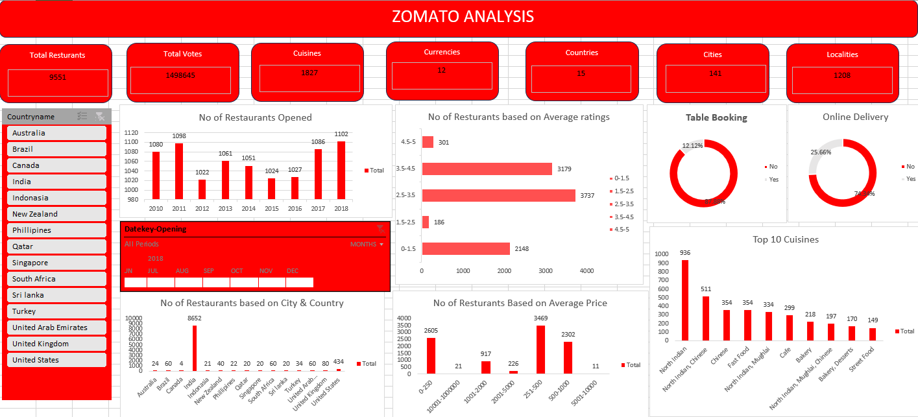
EXCEL DASHBOARD

Slide 17

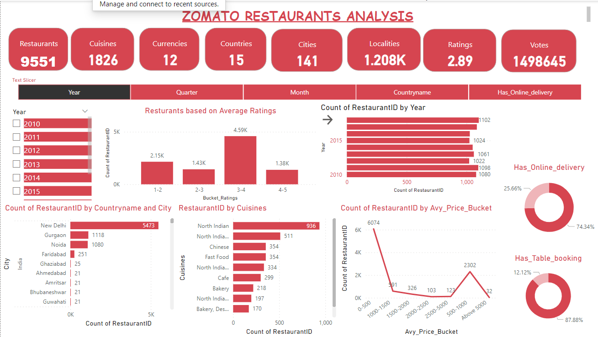
POWERBI DASHBOARD

Slide 18

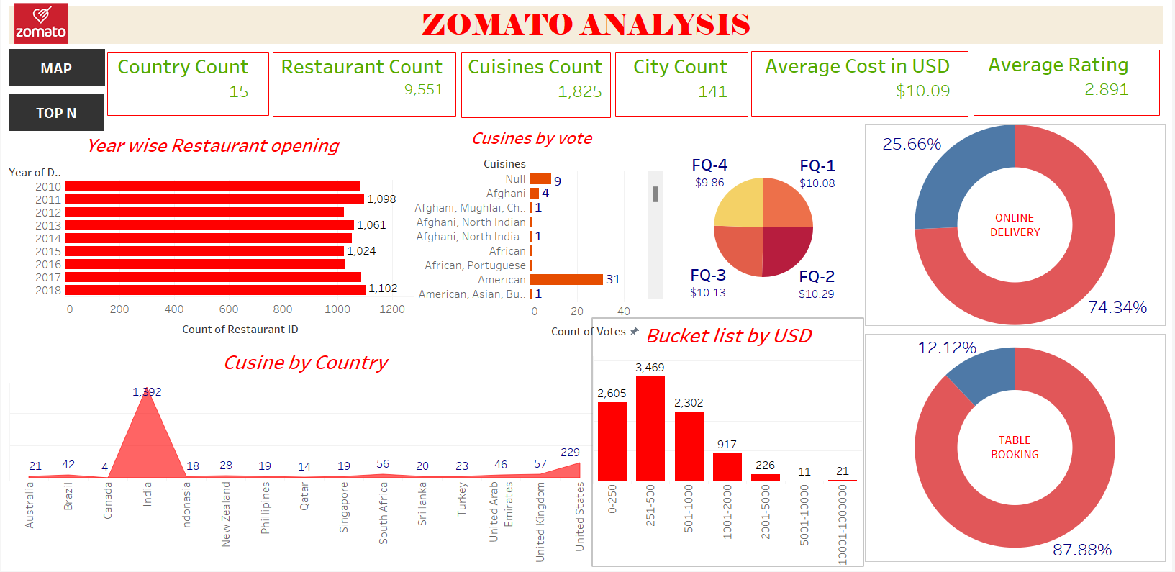
TABLEAU DASHBOARD

Slide 19
SUMMARY
This project delves into Zomato restaurant data to uncover valuable trends and patterns. By analyzing factors like location, opening times, customer ratings, price points, and online service availability, we gain a comprehensive understanding of the restaurant landscape. These insights empower Zomato to:
Target marketing efforts effectively based on customer preferences and demographics.
Identify areas for improvement by pinpointing restaurants with lower ratings or lacking desired services.
Optimize pricing strategies through analysis of popular price ranges and competitor offerings.
Enhance user experience by highlighting convenient features like table booking and online delivery.

Slide 20
INSIGHTS
Customer Cravings: Reveal the hottest cuisine trends and surprising regional favorites.
Price Point Preferences: Understand how price range and cuisine type influence customer satisfaction.
Delivery Dynamos: Uncover which restaurants and cuisines thrive most with online ordering.
Review Revelations: Help restaurants pinpoint areas for improvement based on customer feedback.
Market Movers: Identify potential growth opportunities for new restaurants based on trends.

Slide 21
RECOMMENDATIONS
Leverage seasonality: Analyze trends in restaurant openings to identify peak periods and tailor marketing efforts or resource allocation accordingly.
Focus on under-served markets: Utilize the "Number of Restaurants by City and Country" KPI to discover areas with fewer restaurants, potentially indicating promising locations for expansion.
Target high-value segments: Analyze "Count of Restaurants Based on Average Ratings" and "Restaurant Count by Average Price Buckets" to identify high-rated and specific price-range restaurants, and focus marketing efforts to attract similar customers.
Bridge the service gap: If the "Percentage of Restaurants Based on 'Has_Table_Booking'" is low, explore ways to incentivize or facilitate table booking services for restaurants on Zomato.
Address online delivery trends: Based on the "Percentage of Restaurants Based on 'Has_Online_delivery'", assess if there's an opportunity to expand Zomato's delivery network or differentiate its delivery services to capture a larger market share.

Slide 22
CONCLUSION
In conclusion, this analysis of Zomato restaurant data has provided valuable insights into various aspects of the restaurant landscape. We explored key metrics such as distribution by city, opening trends, average ratings, price ranges, and online service availability. These insights can inform strategic decision-making for Zomato, empowering efforts to enhance user experience, optimize restaurant offerings, and potentially expand the platform's reach.

Slide 23
THANK
YOU

